Slide 1
DIGITAL LOGIC & CIRCUITS LAB
Section :q Group : 2
Supervised By Tanbir Ibne Anwar

Slide 2
TIMELINE
Group Participants
Project Motives
Components
Prospects & Limitation
Summary

Slide 3
Project Motives
Group Participants
Project Vision
Components
uyiu
Summary

Slide 4




Group Participants
Name | ID | Department
NUSHRAT JAHAN | 22-46149-1 | CSE
MD. FAHIM MURSHED | 22-46695-1 | CSE
S.M. MUJAHID SOUROV | 22-49679-3 | CSE
MD. ATIK ISHRAK SUJON | 22-46684-1 | CSE
TRIDIB SARKAR | 22-46444-1 | CSE

Slide 5
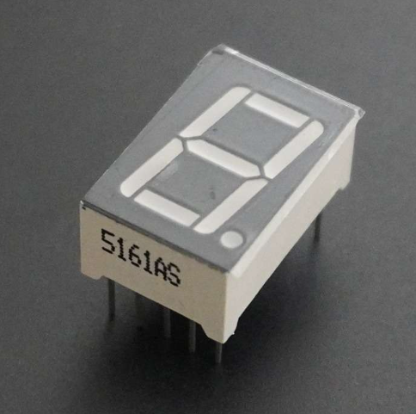
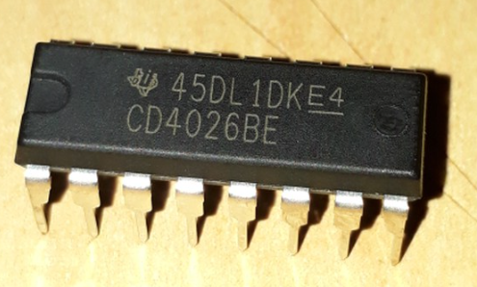
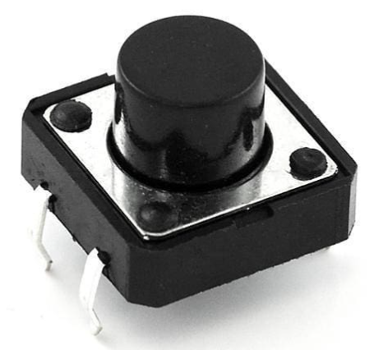
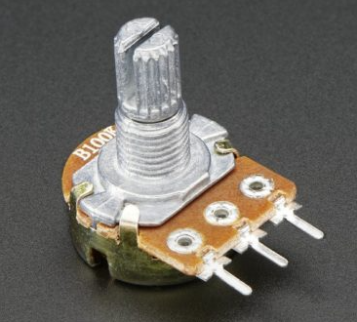
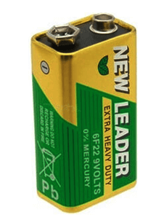
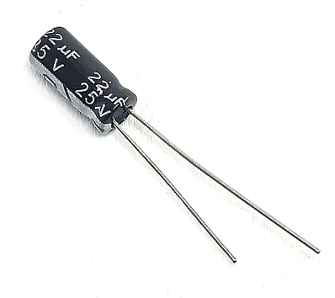
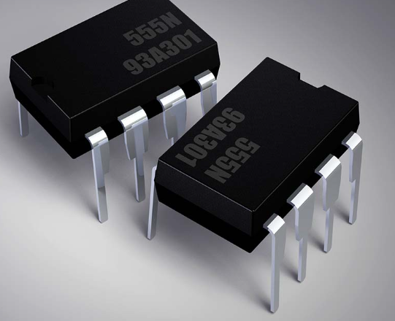
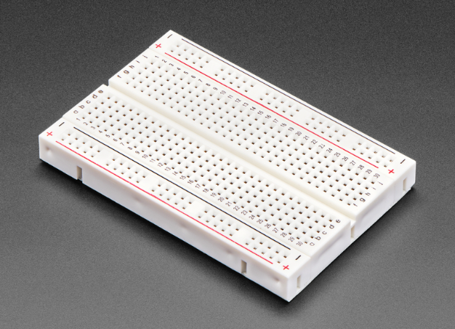
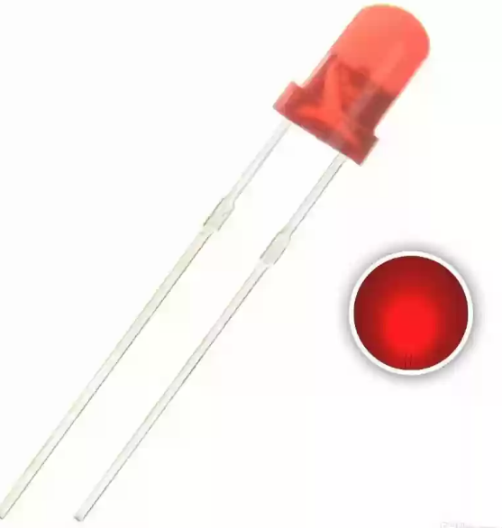
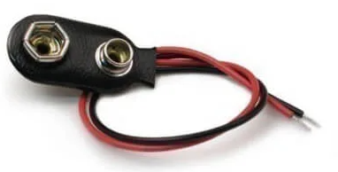

Components
7 Segment Display
IC 4026
Push Button
Potentiometer
9V Battery
22 $μF$ Capacitor
555 Timer
Breadboard
LED
Battery Connector

Slide 6
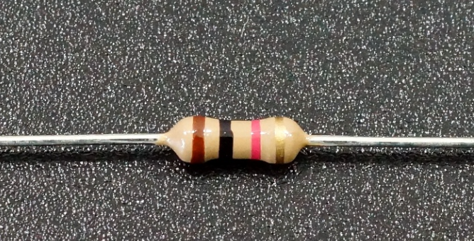
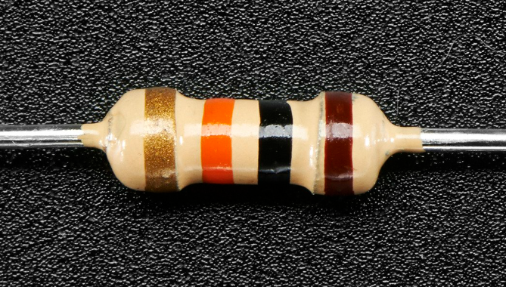
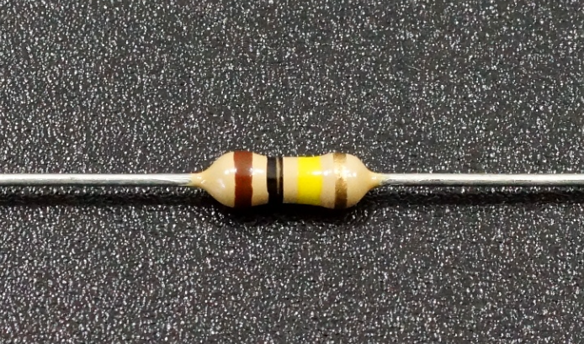
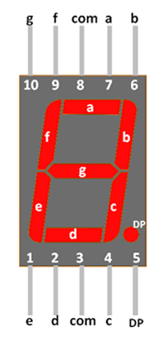
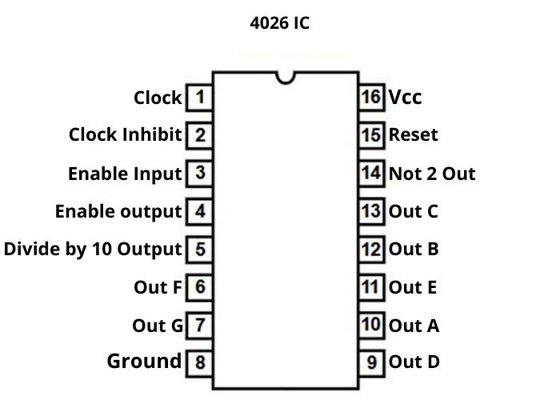
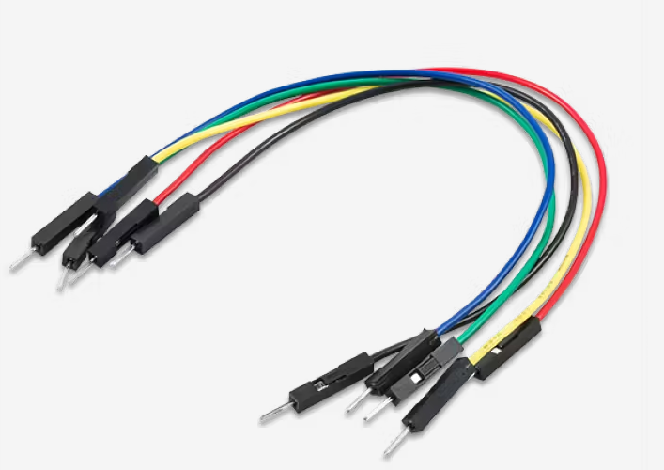
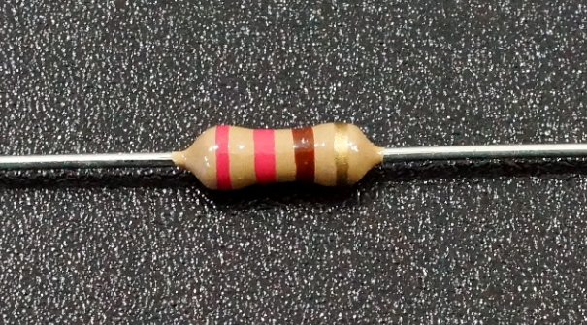
1k Ω Resistor
10k Ω Resistor
100k Ω Resistor
Seven Segment Display Configuration
220 Ω Resistor
Male Connectors
555 Timer Configuration

Slide 7
Prospects & Limitation

Slide 8
Summery
Deploy strategic networks with compelling e-business needs
PLANNING
Synergize scalable e-commerce
MARKETING
Disseminate standardized metrics
DESIGN
Coordinate e-business applications
Foster holistically superior methodologies
LAUNCH
STRATEGY

